Slide 1
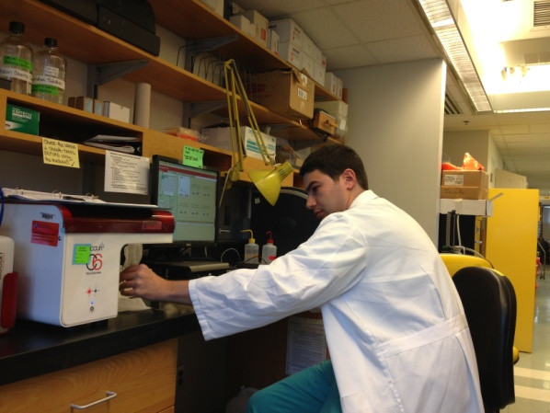
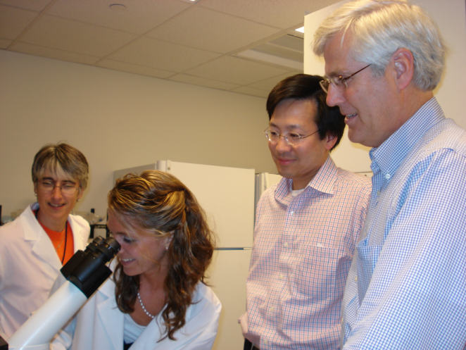
Sarnoff Fellowship
Sarnoff Fellows spend a year conducting intensive work in a research laboratory
Although applicants may have prior research experience, applications are also encouraged from students without extensive prior research experience
Notes:
Dr. Sarnoff designed the fellowship for medical students without extensive prior research experience, but students with experience obviously are also encouraged to apply.
An unique aspect of the fellowship is that students spend a year conducting research in a laboratory at an institution other than their own. This allows the medical student to experience a different academic environment and remove any barriers to working in a high quality lab. The Sarnoff Foundation will fund students with extenuating circumstances (such as family commitments) who wish to stay at their medical school.

Slide 2
Sarnoff Benefits
Annual stipend - $35,000
Fellowship Allowance - $8,000
Financial support to attend the Annual Scientific Meeting and the AHA Scientific Sessions
Additional funds to present research at up to two national conferences
Notes:
The current annual stipend for the fellowship is $35,000 which are provided as monthly payments.
An applicant is not expected to have chosen a laboratory before receiving the fellowship. After a fellow has been granted the fellowship, he or she will work with the Scientific Committee advisor to choose a number of laboratories that would provide an optimal research experience. Up to $8,000 is provided for travel expenses related to these lab visits, moving expenses, and health insurance.

Slide 3
Sarnoff Application
Personal Statement
Essay
Curriculum Vitae
Transcript
Sponsor’s Endorsement
(Member of applicant’s medical school faculty)
Letters of Recommendation
Notes:
Applications for the 2020-21 Sarnoff Fellowship Program are due on January 12, 2022. They include:
-a one page personal statement
-a three page essay, consisting of the following components:
In one page, describe a specific clinical or scientific question or problem relevant to cardiovascular medicine that you find important or interesting. (Note: this problem does not necessarily define or constrain the research topic you will explore during your Sarnoff year)
In two pages, describe 2-3 approaches to examining the problem.
-a CV and medical school transcript
-a letter of endorsement from a member of your medical school faculty who will serve as your “sponsor.” He or she is responsible for assisting you in preparing your application, especially your essay, and for advising you on your laboratory selection along with your Scientific Committee advisor.
-and, letters of recommendation from individuals that can comment on your abilities as an inquisitive and critical thinker.
After the applications are reviewed, up to 20 applicants will be invited for interviews with the Scientific Committee in early March 2022. Up to 12 medical students are granted Sarnoff Fellowship awards. The Scientific Committee places major emphasis on an applicant’s interest in a career in cardiovascular-related research and the ability to reason critically in a scientific fashion.

Slide 4
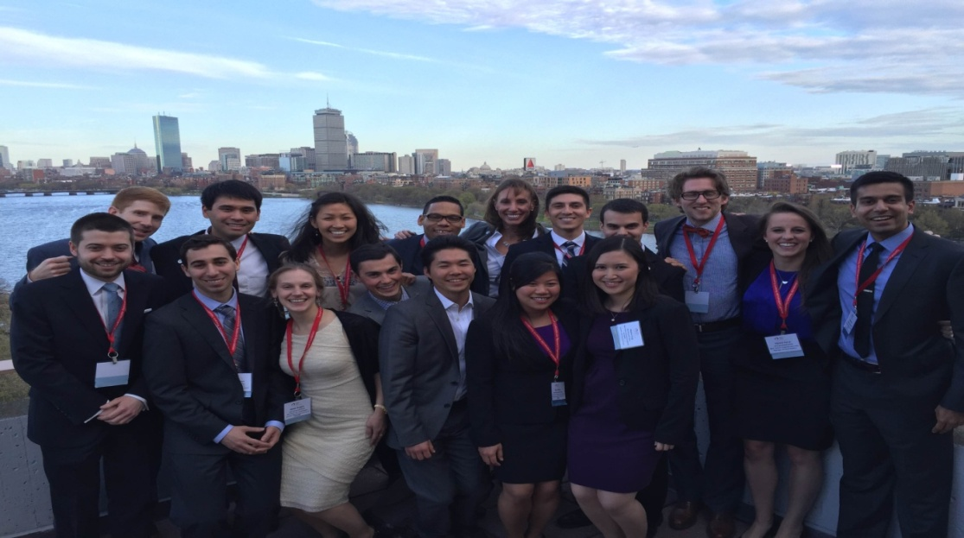
The Sarnoff Advantage
Can conduct research any where in the US
Lifelong Alumni support and offerings
Lifelong mentoring by top physician scientists in the country
Large Alumni Network

Slide 5
Contact Information
Dana Boyd, Executive Director
Sarnoff Cardiovascular Research Foundation
dboyd@SarnoffFoundaton.org
(703) 759-7600
www.sarnofffoundation.org
Notes:
Applications for the Sarnoff Fellowship Program must be submitted online on the Sarnoff website. The website also contains names of potential Sponsors at most US medical schools. You may also contact Dana Boyd for more information.
Thank you for your interest. I’ll be happy to answer any questions.

